Slide 1
IF-less programming in C#
Jiří pokorný jiri.pokorny@solarwinds.com

Slide 2
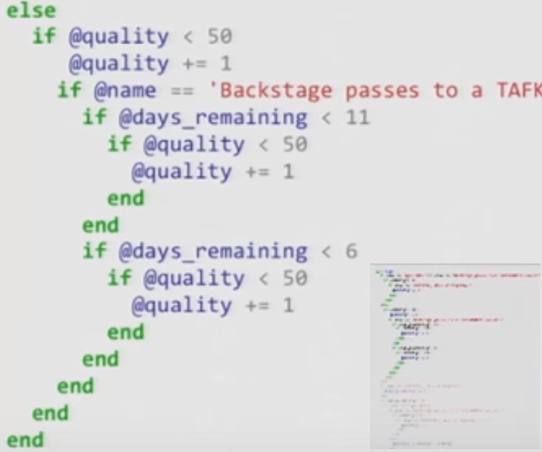
Why IFs considered harmful
GoTo considered harmful (jumps and decisions make code complex)
IF is only encapsulated GoTo statement => It also should be considered harmful
Jules May says about removing IFs:
Way to eliminate 90% of bugs and 99% technical debt
IF causes spaghetti code, which is unreliable
Notes:
Based on following study: http://www.cs.utexas.edu/users/EWD/ewd02xx/EWD215.PDF

Slide 3
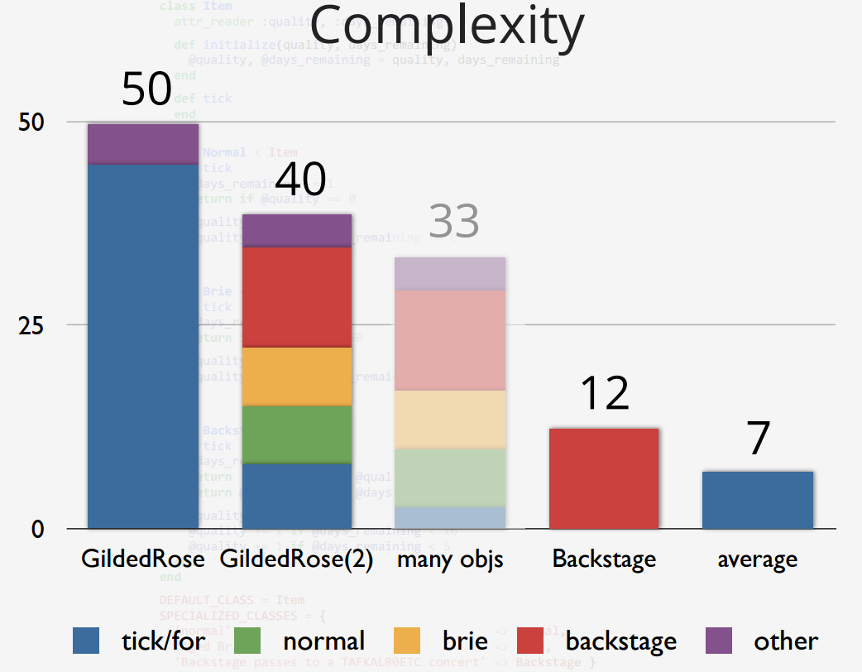
Sandi Metz: RailsConf 2014 - All the Little Things
Complexity is a metric showing code maintainability (smaller is better)
Based on this refactoring example:
Small methods better than one large
Small objects better than one large class
Inheritance is still better than no OOP concept
=> Any of the refactorings leads to less IF statements and better code
Original
Small methods
Final - Small objects
Notes:
Chart explanation:
Each valve represents one refactoring step
Each color represents part of code
Number represents complexity – lower is better
Result was multiple classes with average complexit better than original

Slide 4
Jules May: Solutions
The antidote to GOTO is „Flow-structure“
Structured languages replace GOTO with:
For
While
throw
The antidote to IF is „decision-structure“
„Decision-structured“ language would replace IF with:
The Assert () or …
Value-polymorphism
Downcasts
Notes:
„Decision structured languages“ are OOP or Functional languages
Value polymorphism - where method can be overloaed not only by parameter types, but also by their value. It is not posible in OOP like C#, usually available in functional languages.

Slide 5
How to fix in C#
Dont return Null – always create „Null object“
Merge enum switches into only one
Replace multiple contraints with table definition
Replace workflow with polymorphism
Use IoC to create instances (optional example)

Slide 6
How to fix in C# - DEMO 1.
Merge enum switches into only one
Motivation: We need to implement new device plugin. Currently we need to find all places, where device type enum is used and fix them.
Solution: Extract an interface representing all methods, where the switch is used. Merge all switch statements into one factory, returning the interface implementation based on device type.

Slide 7
How to fix in C# - DEMO 2.
Dont return Null - Always create „Null object“ instead
Motivation: Searching in large object tree, when returning null for „not found“ means, that you are forced later to check for „if(result != null) …“
Solution: Create „Default“ implementation for the edge case and derive implementation for concrete item.

Slide 8
How to fix in C# - DEMO 3.
Replace multiple contraints with table definition
Motivation: Measuring device uses multiple functions how to transform sensor value and you need to change the transformation. Or you need to test each complex part of a complex algorithm.
Solution: Extract all constraints into a table with two colums (condition, algorithm). Use LINQ selection to find required row in the table pointing to expected algorithm.

Slide 9
How to fix in C# - DEMO 4.
Replace workflow with polymorfism
Motivation: You need to put extra step in midle of a tax calculation algorithm.
Solution: Extract steps of the algorithm into separate methods. Extract each possible workflow into one class. Introduce selection method to pick up expected workflow.

Slide 10
Links
https://www.youtube.com/watch?v=8bZh5LMaSmE
http://michaelfeathers.typepad.com/michael_feathers_blog/2013/11/unconditional-programming.html
https://www.youtube.com/watch?v=z43bmaMwagI&index=17&list=PL4vq9TW3wicqc-NkHx-GIEKoPaeeVpyUK
https://www.youtube.com/watch?v=4F72VULWFvc
http://alisnic.github.io/posts/ifless/

Slide 11
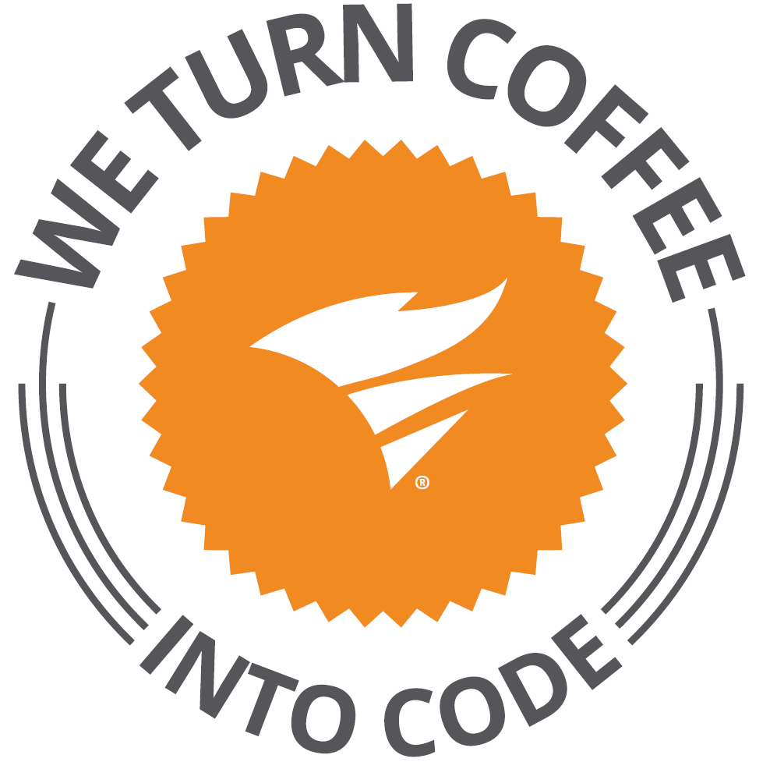
Solarwinds
30+ products for IT Management
Microsoft stack: C#, MS SQL, AngularJS
Brno office – Solarwinds R&D center
https://www.solarwindsmeetup.com/
Career opportunities
http://solarwinds.jobs/
Visit our booth

